Slide 1
SARDAR PATEL UNIVERSITY OF POLICE SECURITY & CRIMINAL JUSTICE
A Presentation Seminar on
FUNDAMENTALS OF INTERNET
BY
Yogendra Singh Chahar

Slide 2
CONTENTS
History of Internet
How Internet is Managed
Architecture of Internet
Basics of Networking
IP Addresses
Packet Switching
Internet Routing
DNS server
Internet Security Essentials

Slide 3
History Of Internet
The history of the Internet started in the United States in the early 1960s.
On October 4, 1957, the Soviet Union launched the first space satellite, Sputnik. The Sputnik success necessitated American reaction. It was a question of pride and leadership. The US Department of Defence responded by establishing the Advanced Research Projects Agency (ARPA).
The main purpose of ARPA was to allow its researchers to share each others’ specialized resources (hardware, software, services and applications) via a Network called ARPANET.
The ARPANET was launched by Bolt Beranek and Newman (BBN) at the end of 1969.

Slide 4
In July 1970, the first packet radio ALOHANET, based on the concept of random packet transmission, was developed at the University of Hawaii by Norman Abramson.
Based on this model, ARPA built its own packet radio network which was called PRNET. ARPA also developed a satellite network, called SATNET.
In 1972, ALOHANET connected to the ARPANET and a commercial version of ARPANET, called TELNET, became the first Public Packet Data Service.
In 1974, Vint Cerf and Robert Kahn developed a set of protocols that implemented the open architecture philosophy. These new protocols were the Transmission Control Protocol (TCP) and the Internet Protocol (IP).
By 1983, all networks connected to the ARPANET made use of TCP/IP and the old Network Control Protocol was replaced entirely. From then on, the collection of interconnected and publicly accessible networks using the TCP/ IP protocols came to be called the “Internet”
Notes:
TCP includes rules that computers on a network use to establish and break connections; IP includes rules for routing of individual data packets. The Transmission Control Protocol/Internet Protocol (TCP/IP) organizes the data into packages, put them into the right order on arrival at their destination, and checked them for errors.
The Telnet protocol was a relatively simple procedure. It was a minimal mechanism that permitted basic communication between two host machines.21 Telnet applications allow users to log on and to operate remote computers.

Slide 5
In 1984, the Department of Defence split the ARPANET into two specialized networks: ARPANET would continue its advanced research activities, and MILNET (for Military Network) would be reserved for military uses that required greater security.
By 1987, when the number of hosts reached 10,000, congestion on the ARPANET caused by the limited-capacity leased telephone lines was becoming complicated. To trim down the traffic load, a network run by the National Science Foundation, called NSFnet, merged with another NSF network, called CSNet, and with BITNET to compose one network that could carry much of the network traffic.
In 2000’s Connectivity was no longer the issue; rather, navigating and finding the information you needed in the growing maze was difficult.
Addressing this challenge, two Stanford graduate students, Larry Page and Sergey Brin, started to work on a search engine which they called BackRub, as it was designed to analyze a ‘back link’ on the Web.

Slide 6
How Internet is Managed
There are few companies which manages the backbone of internet, namely AT&T, GTE, IBM, etc. And many more things are done by them like…….
Access to the Internet or a VPN.
A dedicated port into the AT&T OC48/192 Common Backbone, which has no single core backbone point of failure.
Service level agreements with 100 percent service reliability and 99.95 percent data delivery.
24x7x365 monitoring and technical support.
AT&T or customer provided equipment.
Synchronous high-bandwidth data transfer speeds.

Slide 7
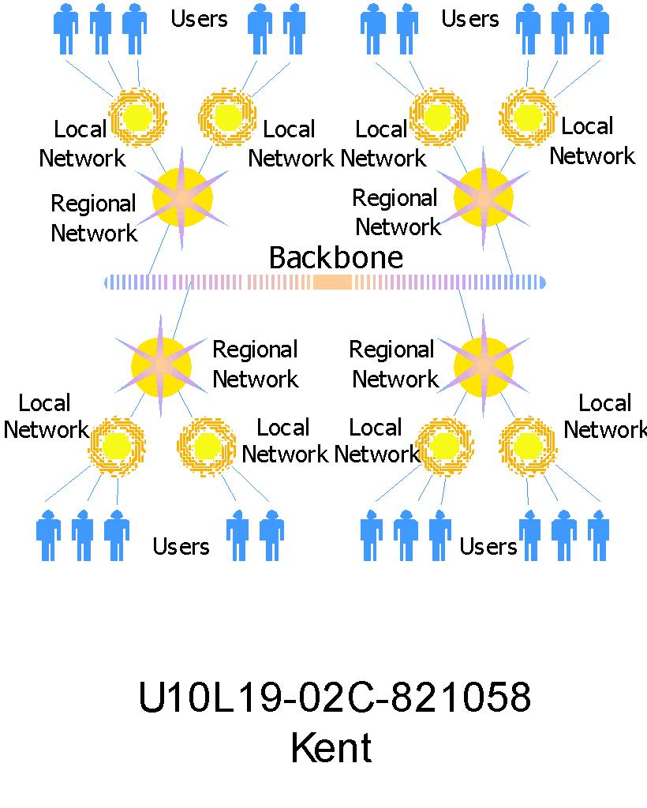
Architecture of INTERNET

Slide 8
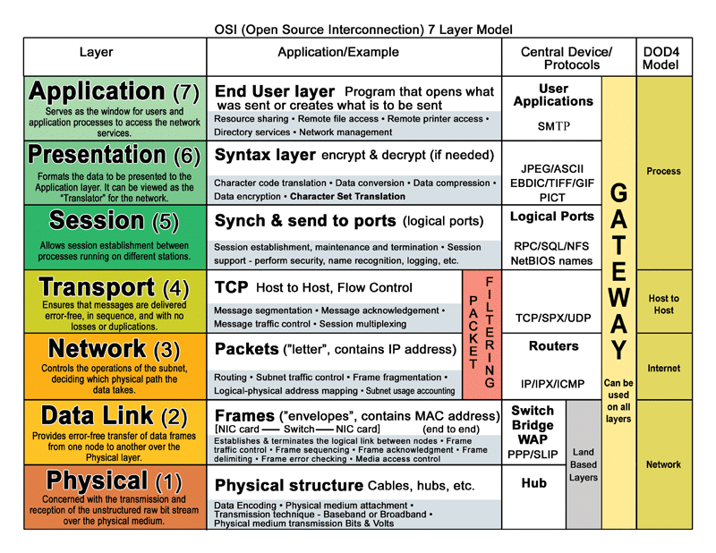

Slide 9
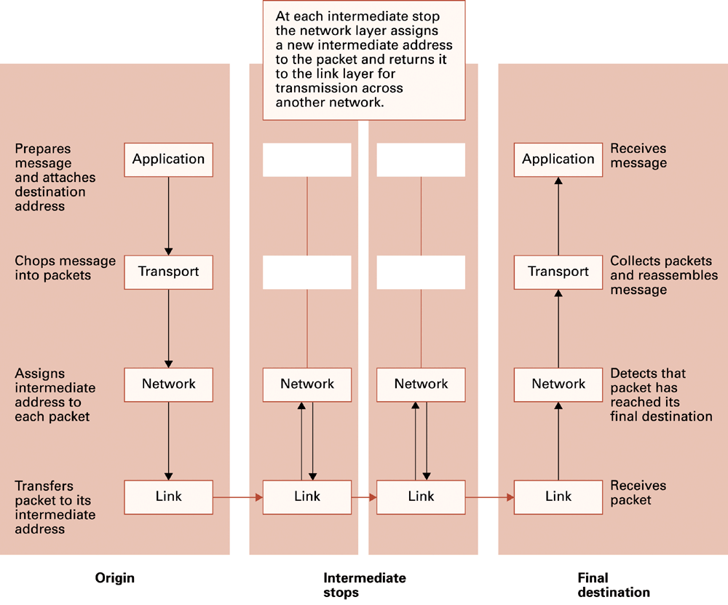
TCP/IP protocol Stack

Slide 10
Basics Of Networking
Computer network :
A collection of computing devices that are connected in various ways in order to communicate and share resources. Usually, the connections between computers in a network are made using physical wires or cables. However, some connections are wireless, using radio waves or infrared signals.
Types of N/W:
LAN
MAN
WAN
PAN
What is Difference B/W Internet, Intranet & Extranet ?

Slide 11
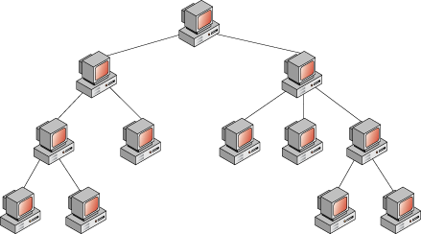
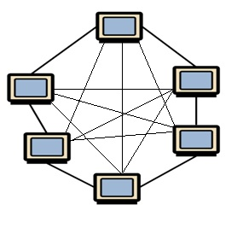
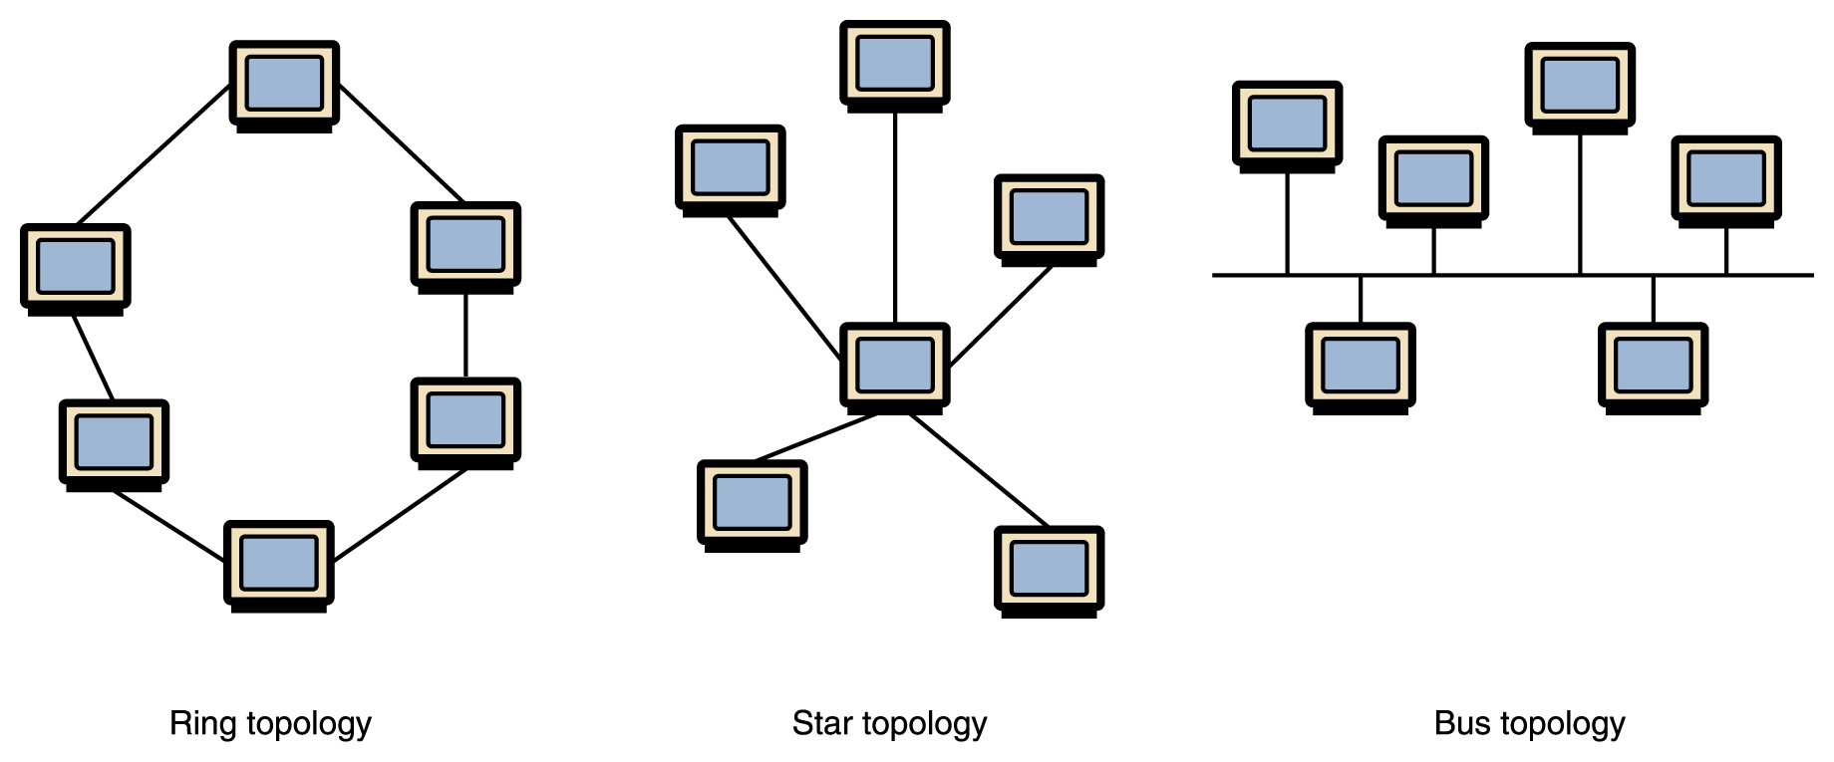
Types Of Network Topologies :
Bus Topology
Ring Topology
Mesh Topology
Tree Topology
Star Topology
Hybrid Topology
Tree
Toplogy
Mesh topology

Slide 12
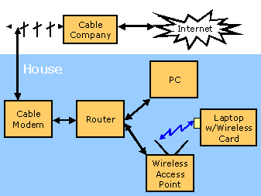
Sample LAN Implementation Home Configuration

Slide 13
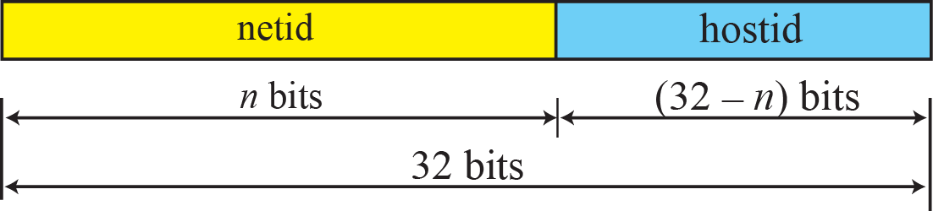
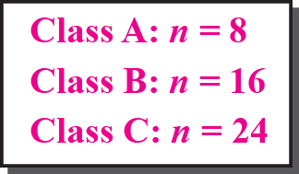
IP Addresses
The identifier used to identify each computer connected to internet.
IP address is unique. Generally of two types,
Classfull
Classless
In our day to day life generally IPv4 is used.
It is a 32 bit long binary combination
Addressing rule says that no. of terminals in a network with different IP can be 2^n
The address space of IPv4 is 2³² or 4,294,967,296.
Basically there are 5 classes of IP Address, namely A, B, C, D, E

Slide 14
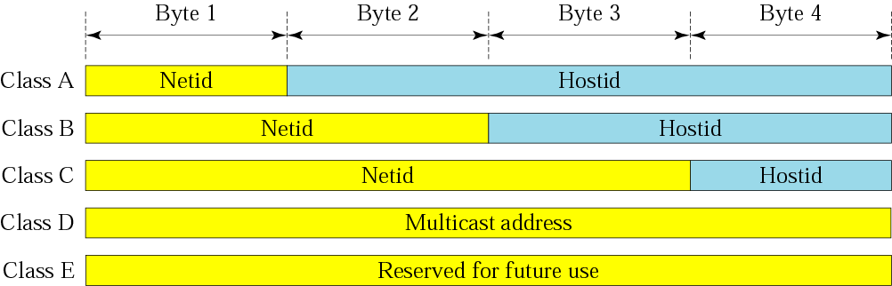
Classes | Starting Address | End Address | Usage
A | 0.0.0.0 | 127.255.255.255 | Very huge network
B | 128.0.0.0 | 191.255.255.255 | Large network
C | 192.0.0.0 | 223.255.255.255 | Small network
D | 224.0.0.0 | 239.255.255.255 | broadcasting
E | 240.0.0.0 | 255.255.255.255 | Reserved for future

Slide 15
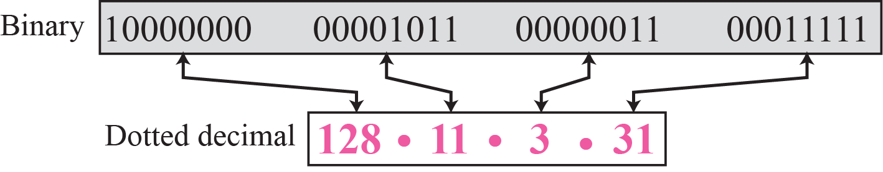
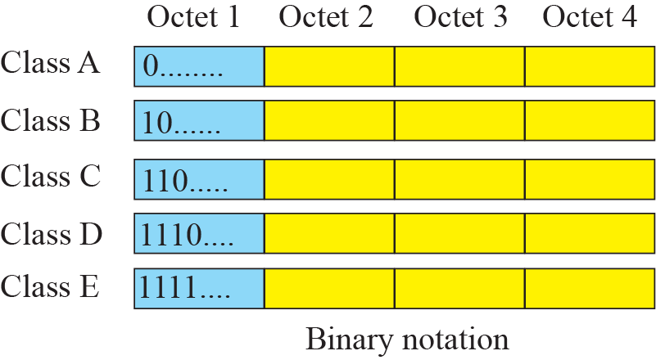
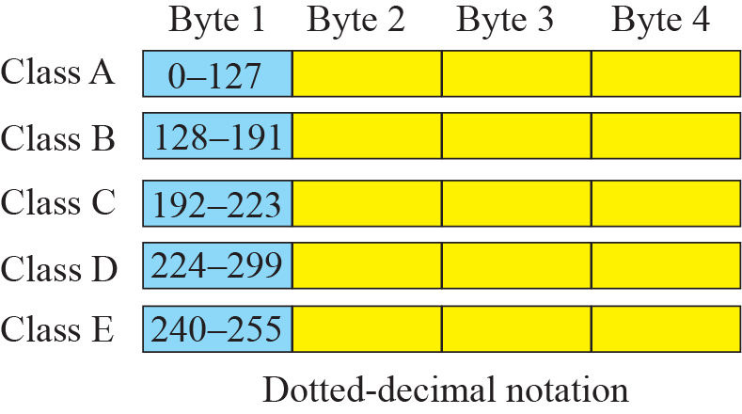

Slide 16
Different Types of Networks
communication network
switched network
broadcast communication
circuit-switched network
packet-switched network
datagram network
virtual circuit network

Slide 17
 | circuit switching | packet switching
resource usage | use a single partition bandwidth | use whole link bandwidth
reservation/setup | need reservation (setup delay) | no reservation
resource contention | busy signal (session loss) | congestion (long delay and packet losses)
charging | time | packet
header | no header | per packet header
fast path processing | fast | per packet processing

Slide 18
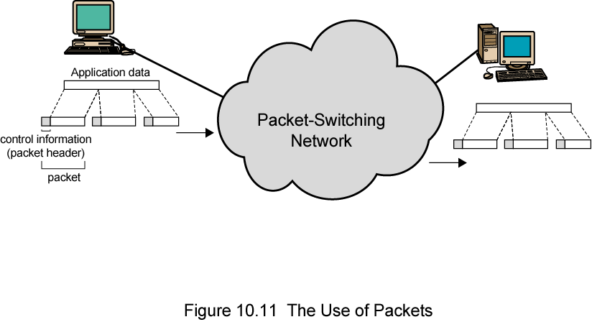

Slide 19
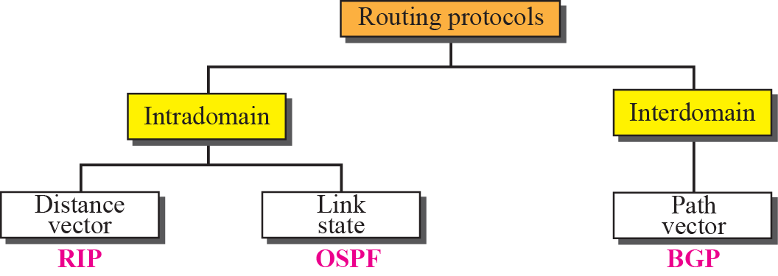
Internet Routing
An internet is a combination of networks connected by routers. When a datagram goes from a source to a destination, it will probably pass through many routers until it reaches the router attached to the destination network.

Slide 20
DNS Server
The “Domain Name System” Created in 1983 by Paul Mockapetris (RFCs 1034 and 1035)
The mechanism by which Internet software translates names to addresses and vice versa
IP assigns 32-bit addresses to hosts (interfaces).
Binary addresses are easy for computers to manage .
All applications use IP addresses through the TCP/IP protocol software.
Difficult for humans to remember.
Domain names comprise a hierarchy so that names are unique, easy to remember.

Slide 21
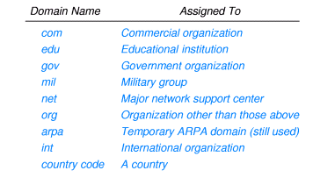
Few TLD’s that are commonly used

Slide 22
Root Name Server Operators
Nameserver | Operated by:
A | Verisign (US East Coast)
B | University of S. California –Information Sciences Institute (US West Coast)
C | PSI (US East Coast)
D | University of Maryland (US East Coast)
E | NASA (Ames) (US West Coast)
F | Internet Software Consortium (US West Coast)
G | U. S. Dept. of Defense (ARL) (US East Coast)
H | U. S. Dept. of Defense (DISA) (US East Coast)
I | KTH (SE)
J | Verisign (US East Coast)
K | RIPE-NCC (UK)
L | ICANN (US West Coast)
M | WIDE (JP)

Slide 23
Internet Security
Attacks
Malware (viruses, worms, Trojan horses, spyware, phishing software)
Denial of service
Spam
Protection
Firewalls
Spam filters
Proxy Servers
Antivirus software

Slide 24
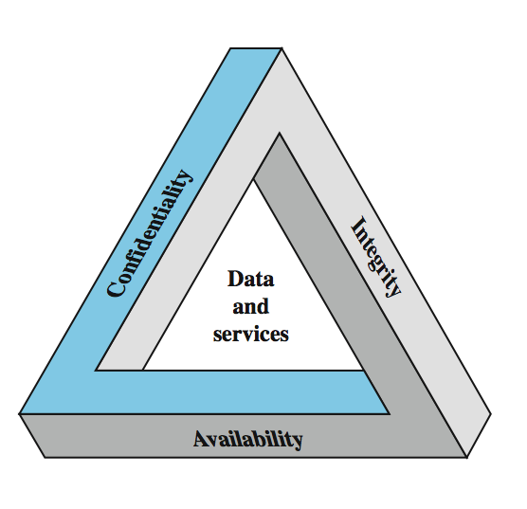
Key Security Concepts

Slide 25
Attacks
Virus – s/w that infects a computer by inserting itself into programs that already reside in the machine. When the host program is executed, the virus is also executed.
Worm – autonomous program that transfers itself through a network, taking up residence in computers and forwarding copies of itself to other computers.
Trojan horse – program that enters a computer system disguised as a desirable program (such a game or utility package) that is willingly imported by a victim. Once in the computer, the trojan horse performs additional activities (most likely with harmful effects).
Spyware (sniffing) – software that collects information about the activities of computer that it resides and sends that information back to the instigator of the attack.
Phishing – rather than obtaining the information in secret, this techniques asks explicitly for it.
DoS (Denial Of Service) – attack from other machines in the network, by overloading the victim computer with messages.
Spam – abundance of unwanted messages (e-mail)

Slide 26
Protection
Firewall – primary prevention technique to filter traffic passing through a point in the network (e.g. installed on the router/gateway into an organization). Used also to protect individual computers too (rather then entire network)
Spam filters – specific purpose firewalls, designed to block unwanted e-mail
Proxy server – software unit that acts as intermediary between a client and a server with the goal of shielding the client from adverse actions of the server. This prevents the server to find out certain unwanted details about the client.
Antivirus software – software used to detect and remove presence of known viruses and other infections, specialized in virus control and spyware protection.

Slide 27
Encryption
Many traditional Internet applications have been altered to incorporate encryption techniques, producing what are called secure versions.
FTPS – secure version of FTP
HTTPS – secure version of HTTP using SSL (Secure Sockets Layer)
They involve public key encryption
One public key is used to encrypt messages
One private key is used to decrypt messages
Public key is first distributed to those that need to send messages in confidence to a particular destination.

Slide 28
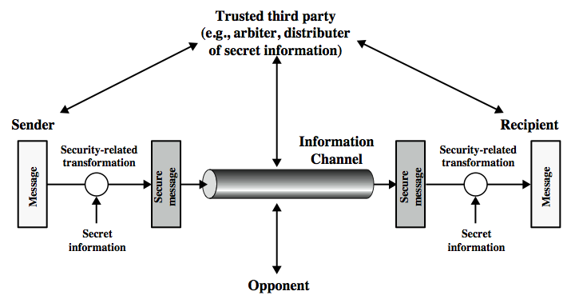
Network Security Model

Slide 29
References
http://www.wikipiedia.org/History_of_internet
http://www.seminaronly.com/computer-science/Internet
http://www.slideshare.net/IPv4
http://www.wikipiedia.org/Packet-Switching
www.nptel.com/downloads/networking/basic.pdf

Slide 30
QUERIES ???

Slide 31
THANK YOU

